Slide 1


PROJECT COMMUNICATION MANAGEMENT
1

Slide 2




Table of content
Project communication: Overview | 1
PMBoK Communication Processes | 3
Plan Communication Management | 7
Manage Communication Management | 12
Monitor Communication Management | 16
Communication in Agile Environment | 23
Be an example in helping your team set clear boundaries. | 26

Slide 3
Course Objectives
Walk through
Project Communication Management
processes of PMBoK
Common understanding of
Project Communication Management
Discuss on
Project Communication Management
in Agile environment
Practical Management of
Project Communication
In Fsoft

Slide 4

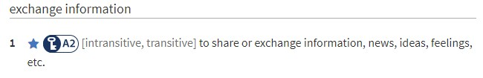

Communication
Project Communication Management
to ensure that the information needs of the project and its stakeholders are met through the development of artifacts and implementation of activities
to achieve effective information exchange.
Communication is the key factor to a project success.

Slide 5
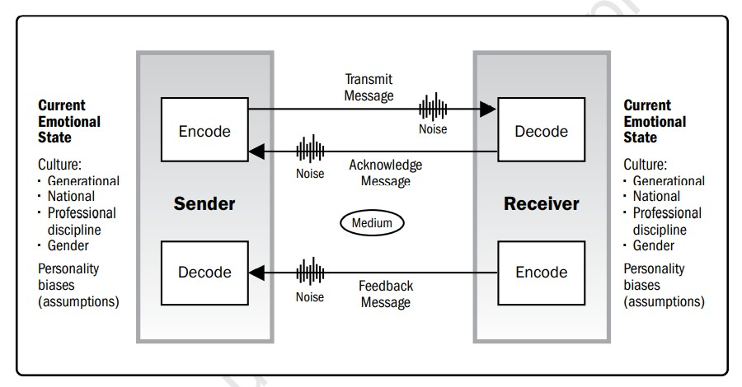
Basic Communication model
Sample of communication medium
Notice boards,
Newsletters/in-house
magazines/e-magazines,
Letters to staff/volunteers,
Press releases,
Annual reports,
Emails and intranets,
Web portals and other information repositories (for pull communication)
Phone conversations,
Presentations,
Team briefings/group meetings,
Focus groups,
Face-to-face formal or informal meetings between various stakeholders,
Consultation groups or staff
forums, and
Social computing technology and media
Encoding – transform (sender’s) idea to voice/language/digital/analog
formats…
Message – output of encoding process.
Medium – tools/environment in which the message is being transmitted.
Noise – Interference with transmission/understanding.
Decoding – receive message and transform to (receiver’s) idea.
Effective Communication:
- Correct mutual encoding & decoding
- Reduce noise
- Reliable medium
- Integrity message

Slide 6

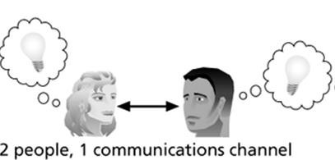
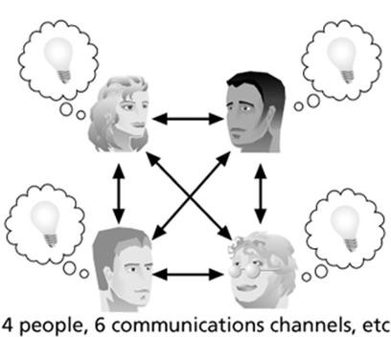
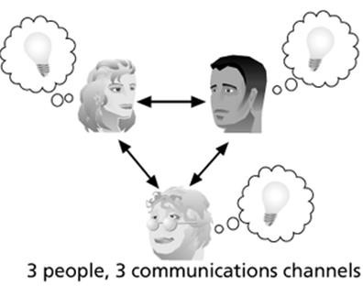
Key concepts & terms
FORMAL vs INFORMAL
WRITTEN vs VERBAL
• FORMAL WRITTEN
• INFORMAL WRITTEN
• FORMAL VERBAL
• INFORMAL VERBAL
CHANNELS
(n*(n-1))/2
FORMS
Interpersonal Small group Public
Mass
Network & social computing
METHODS
Interactive communication
Push communication
Pull communication

Slide 7






Effective Communication (in projects)
Completeness
Clear Courtesy
7C
Creativity
Correct
EFFECTIVE
COMMUNICATION
Concise
Consideration
RIGHT PEOPLE
3R
RIGHT TIME
RIGHT MESSAGE

Slide 8



Questions
Please feel free to discuss on Communication in project:
How do you think communication in project is important?
What are your project’s communication issue(s) so far?

Slide 9

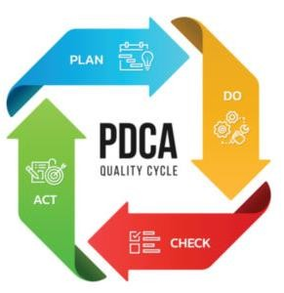
PMBoK guide on Project Communication Management
PREREQUISITE:
Identify Stakeholder:
Who to communicate with and their flavor of communication?
MAIN PROCESSES:
Plan Communication Management (Plan)
How should we communicate with Stakeholders in the project?
Manage Communication Management (Do-Act)
Implement the plan, transmit information, interact with Stakeholder.
Monitor Communication Management (Check) Observe - Measure – Analysis – Adapt, to make better communication in the project
TARGETS:
Reduce noise
Reliable medium
Correct mutual encoding & decoding
Integrity message

Slide 10



Step 0: Identify who are going to communicate with ?
(stakeholder engagement plans)
Project Team
Client / Customer
Management
And YES, there are plenty more… please review Stakeholder Engagement Management.

Slide 11

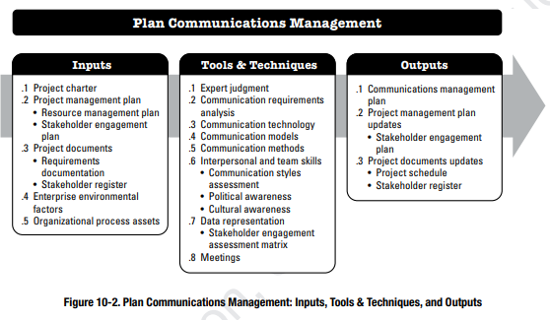
Step 1: Plan Communication Management
Inputs
Stakeholder register & analysis
Other documents
Tools & Technique Technology – Model – Methods Cultural/Political awareness
Outputs
Communication plan (see next)
Documents updates

Slide 12
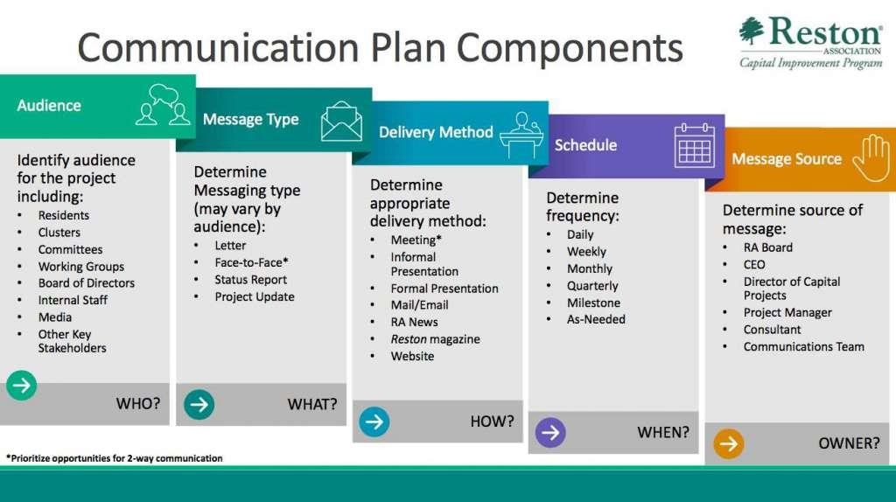

Slide 13
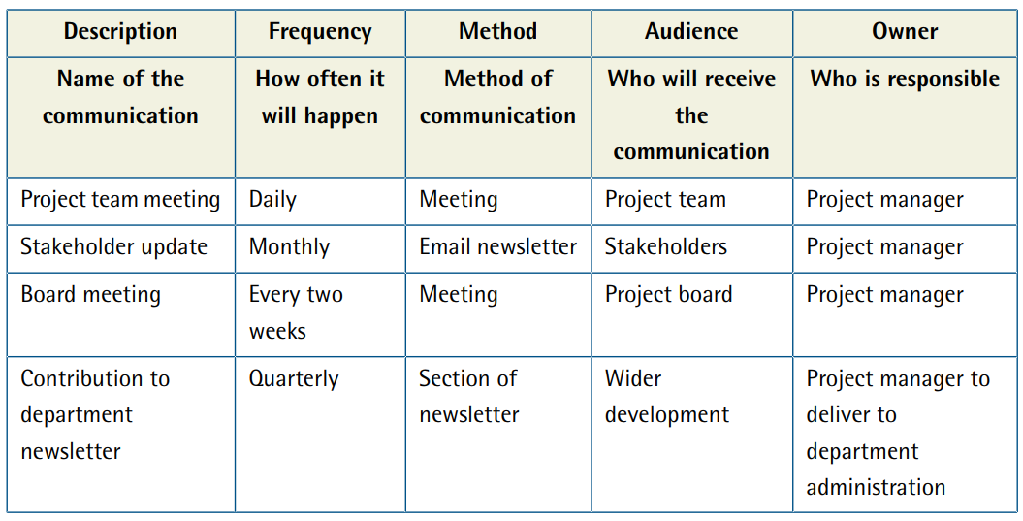
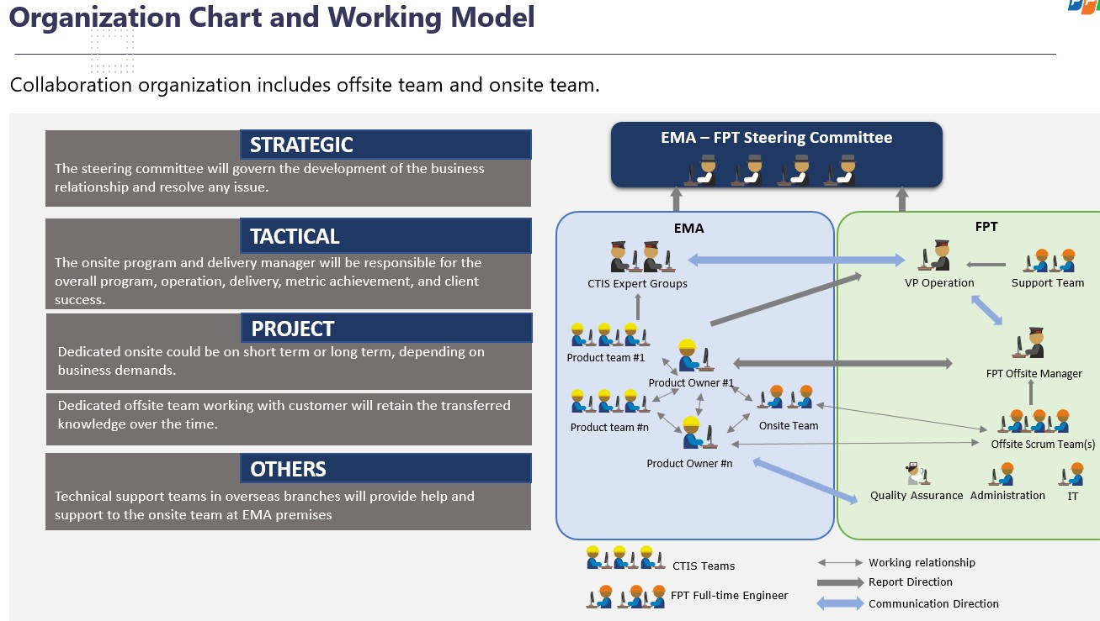
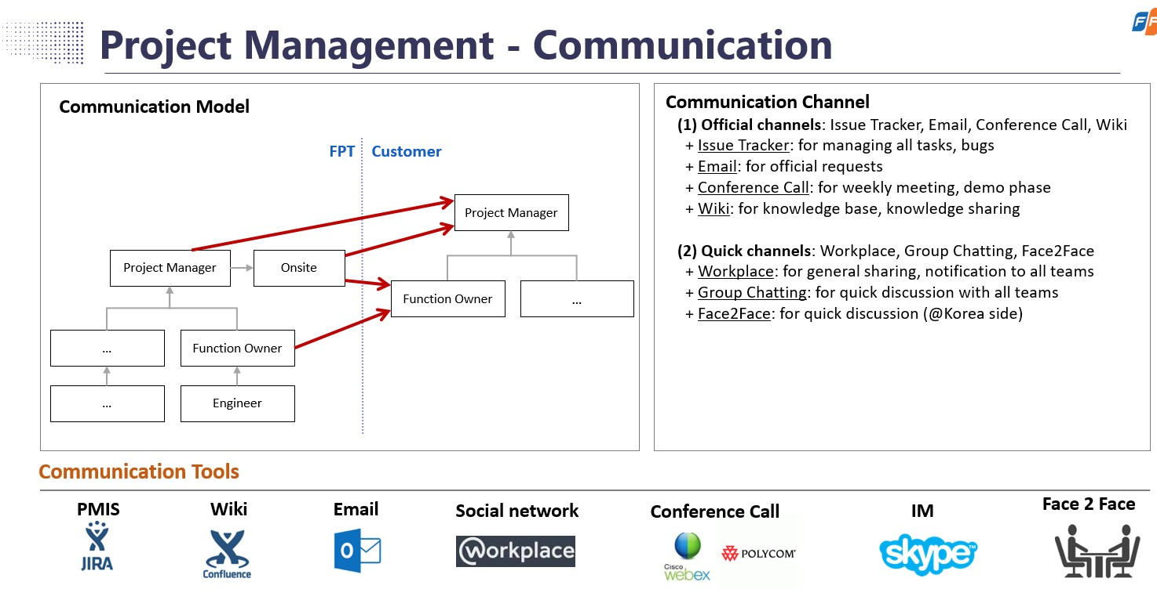
Communication Plan: Representation
Meeting Calendar
Escalation Path
3/18/2021 43e-BM/HR/HDCV/FSOFT
V1.2 - ©FPT SOFTWARE – Corporate Training Center
13

Slide 14
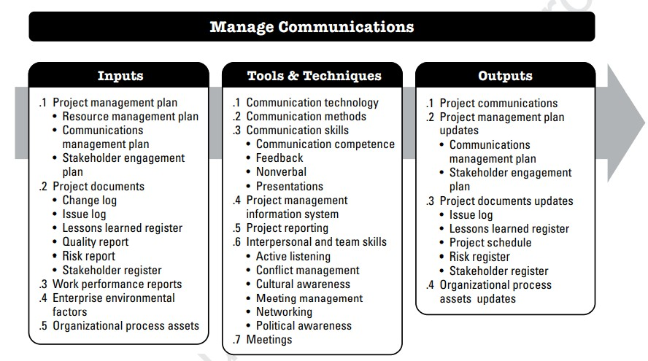
Step 2: Manage Communication Management
(implement the plan)
Inputs Communication Plan Documents
KPIs
Tools & Technique Communication skills Interpersonal & team skills
Outputs
Communication plan updates
Documents updates

Slide 15
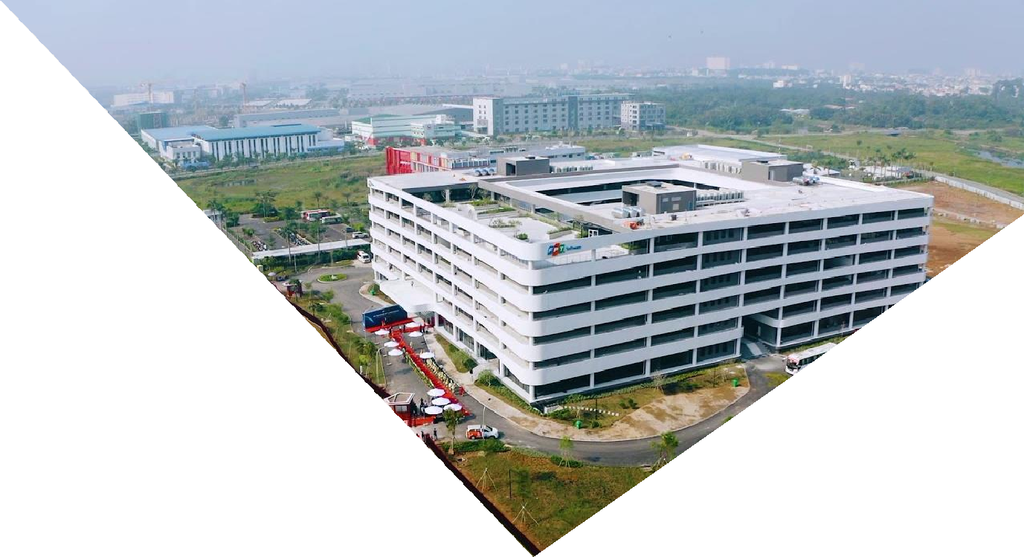

Communication tools & technique
Communication & Interpersonal & Team Skills
Communication skills
Communication competence
Feedback
Non verbal
Presentation
…
Interpersonal & Team skills
Active listening.
Conflict management.
Cultural awareness
Meeting management:
preparation, rules, focus, time, output, conclusion…
Networking
Political awareness.
…

Slide 16

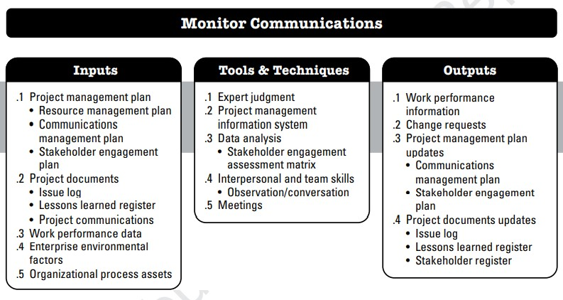
Step 3: Monitor Communication Management
(Observe, analysis, and update the plan)
Inputs Communication Plan Documents
KPIs
Tools & Technique
Interpersonal & team skills
Outputs
Communication plan updates
Change request
Documents updates

Slide 17

Communication in Agile environment
Iteration
planning
Information
radiator
Daily stand-up
transparency
Shared vision
F2f comm.
Open talk
collaborative
Co-locating
Knowledge
sharing
Improve plan
continuous improvement
Osmotic comm.
System
thinking
retrospective
System thinking
Pair work

